Slide 1
Automatic Parking Lot
By:
Mukesh Kr. Agarwal, 10323007(TL)
Dileep Singh,09305003

Slide 2
PROJECT PROBLEM STATEMENT
Developing a automated parking lot where vehicle can be parked at specific parking space commanded by central sever and also able to unpark the vehicle when demanded.
System should be a
  fully automated
  perform the required operations.

Slide 3
REQUIREMENTS
Hardware Requirements :
  White Line sensor
  Zig-bee Interface.
  Fire-Bird Programmer.
Software Requirements
  AVR Studio 4: IDE for programming AVR micro-controllers.
  C- language

Slide 4
REQUIREMENTS CONT…
Communications Interfaces :
  Zig-bee modules were used for communication.
  Zig-bees were paired up so that they send data to and received data from particular Zig-bee modules only that too on a particular channel.
  Data packets from non paired Zig-bee modules and non matching channels were dropped.
  Receive commands.
  Move to the required location

Slide 5
Implementation
Functionality
  Zig-bee communication
  Parking
  Unparking

Slide 6
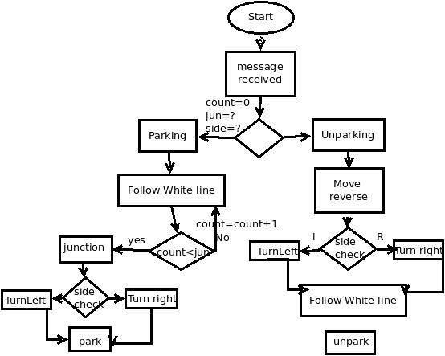
Flow Chart

Slide 7
Challenges
  Esteral signal handling
  Speed synchronization of both wheel
  Zig-bee communication setup
  Straight reverse motion of the bot
  The angular rotation of the robot is sometimes unpredictable due to the unbalanced wheel motion and power supply issues

Slide 8
Testing Strategy and Data
For Worker Robot
  A 3x2 parking area is created
  Parking an unparking command is given by central server, manually to bot through Zig-bee
  Bot follow white line considering as road
  When bot reaches required junction it turn specified parking space and park itself
  When unpark signal is receive bot move in reverse direction to the junction

Slide 9
Discussion of System
Worked :
  Automatic parking in esteral
  Zig-bee communication setup
  Centralized automatic parking and unparking in C language
Thing did't work
  Automated unparking in esteral was unable to handle signal in esteral
  Stacked parking and time constrained parking strategy didn't work and because lot of time consume in basic building and zig-bee communication setup in esteral hence ran out of time.

Slide 10
Re-Usability Feature
  Interface for various modules
  Each module can be independently developed, debugged and tested
  Code is commented properly
  Complete documentation is provided
  Design algorithm for future work in document.

Slide 11
Future Work
It can be implemented on multiple bot and multiple Lane simultaneously.
It can be implemented stacked parking depend on parking time.
Space optimization for parking Lot.

Slide 12
References
1. http://www.e-yantra.org/ci/projects :Automatic Parking
2. Fire-Bird V AVR2560 Hardware Manual
3. FireBird V AVR2560 Software Manual

